Slide 1

Predicting future outcomes for Turtle Games with Python and R
by Aleksandra Koerkemeier

Slide 2
Turtle Games has a business objective of improving overall sales performance by utilising customer trends.

Slide 3
Data analysis
In my report I have detailed:
Main stakeholder questions
Available data
Steps taken in analysis (Python notebook and R scrip are both available)
Uncovered information in terms of the customer persona and sales

Slide 4
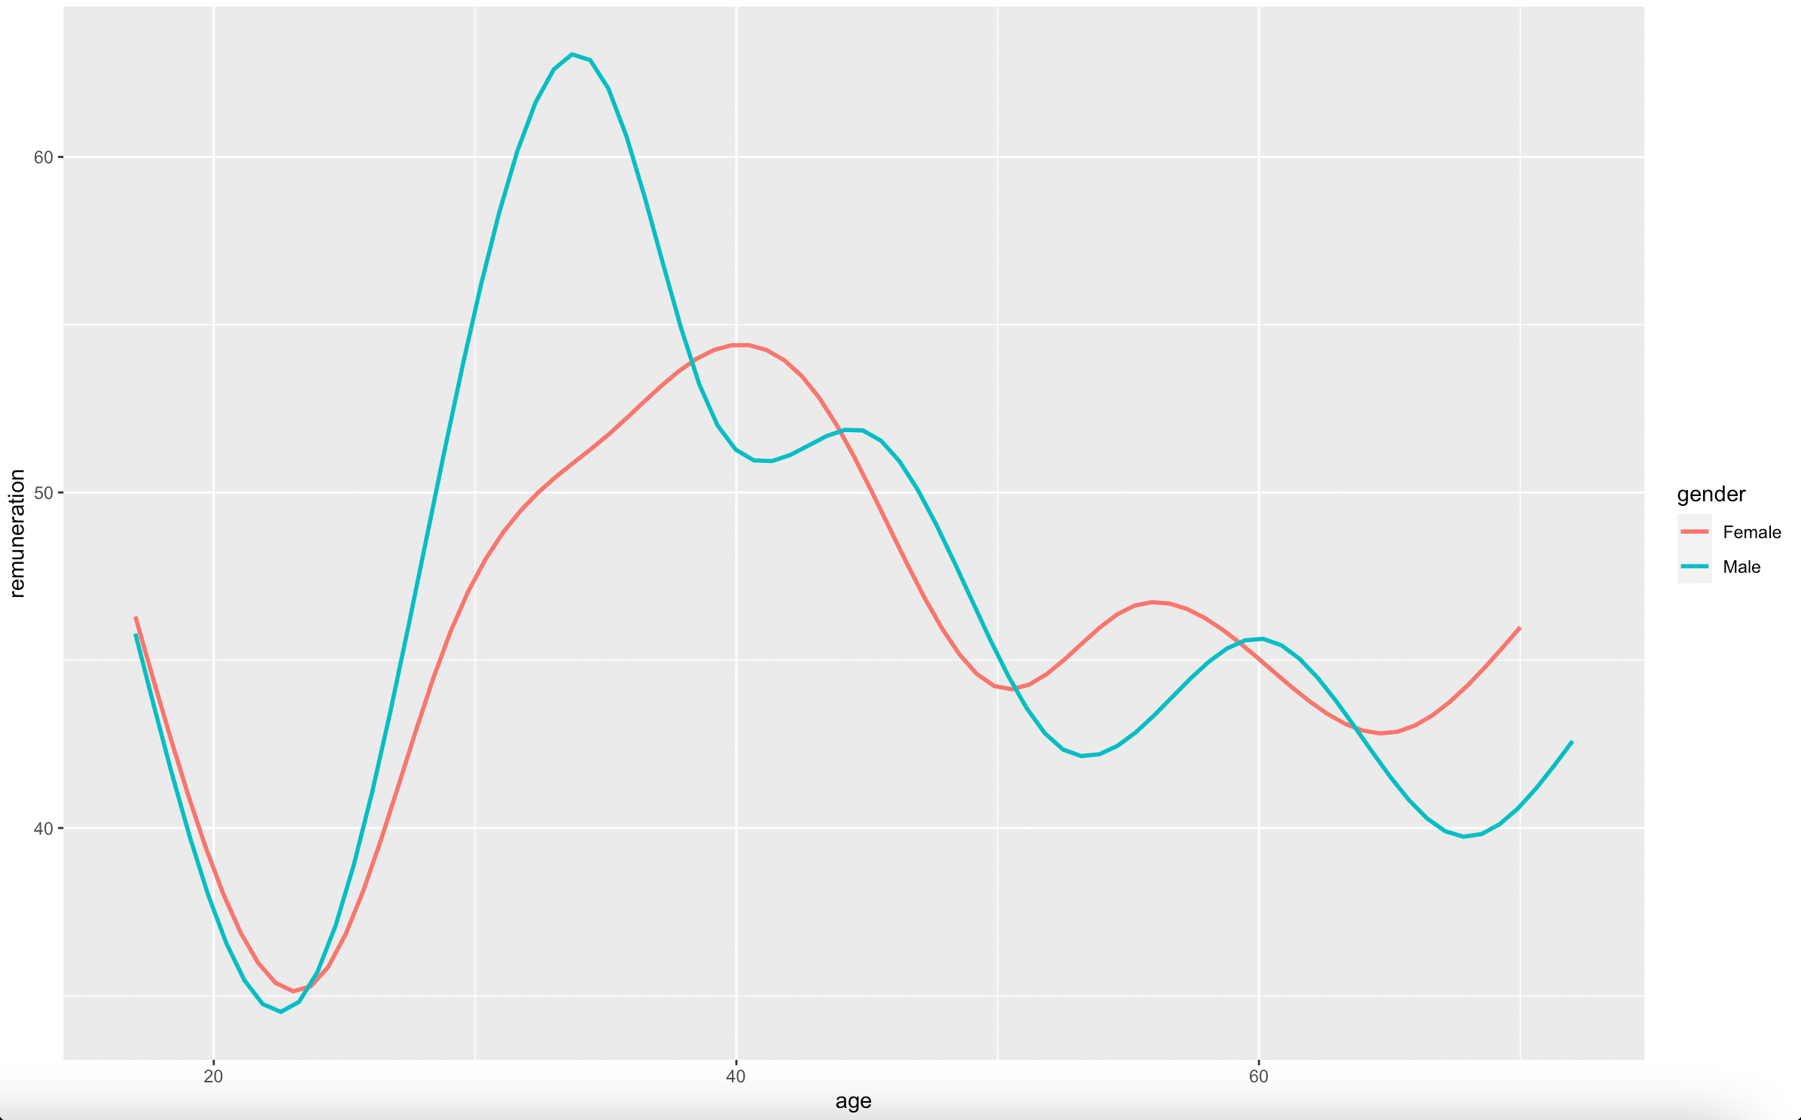
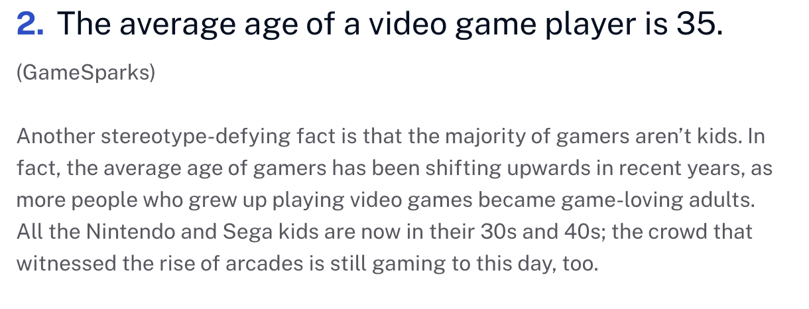
Recommendations: age
According to Statista there will be 3.3 billion players worldwide until 2024.
According to research conducted by GameSparks average gamer age is around 35.
Look into Turtle Games data shows that male and female buyers between 30-45 are the perfect target audience.
This can be used to better target all digital marketing campaigns.

Slide 5
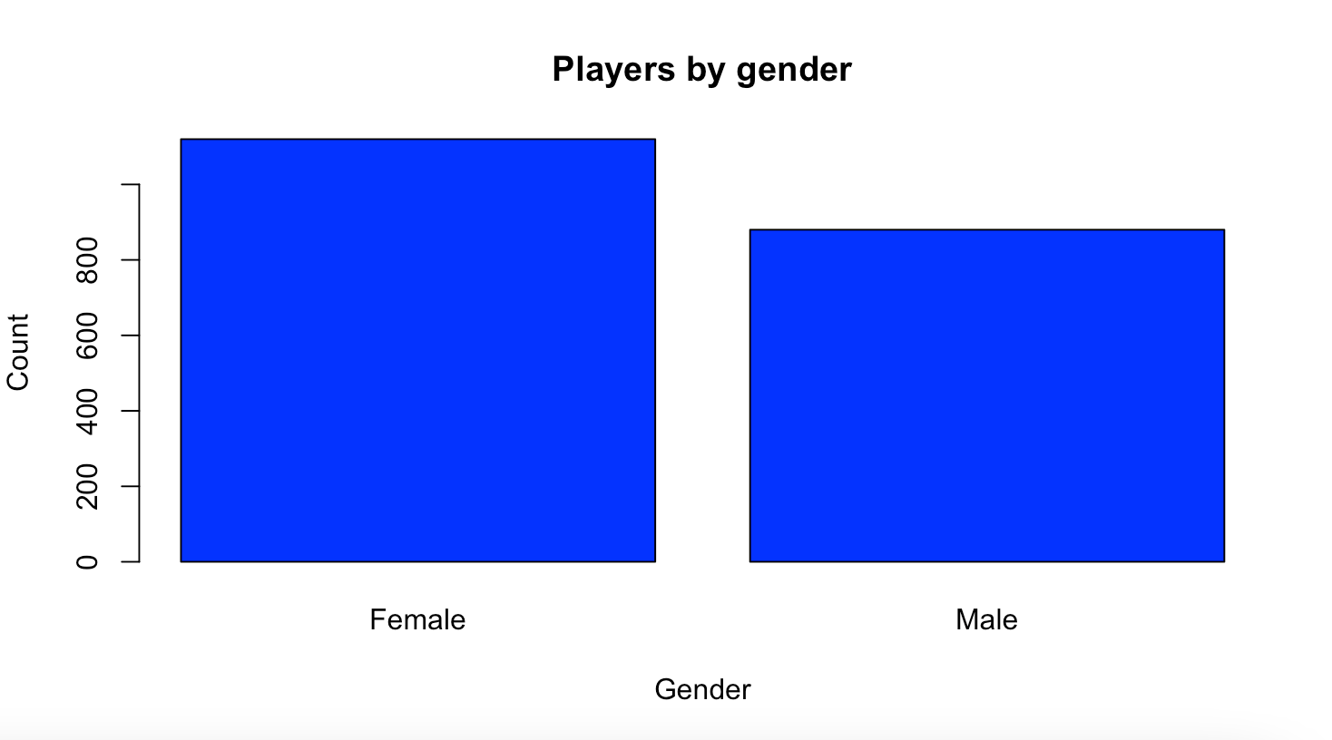
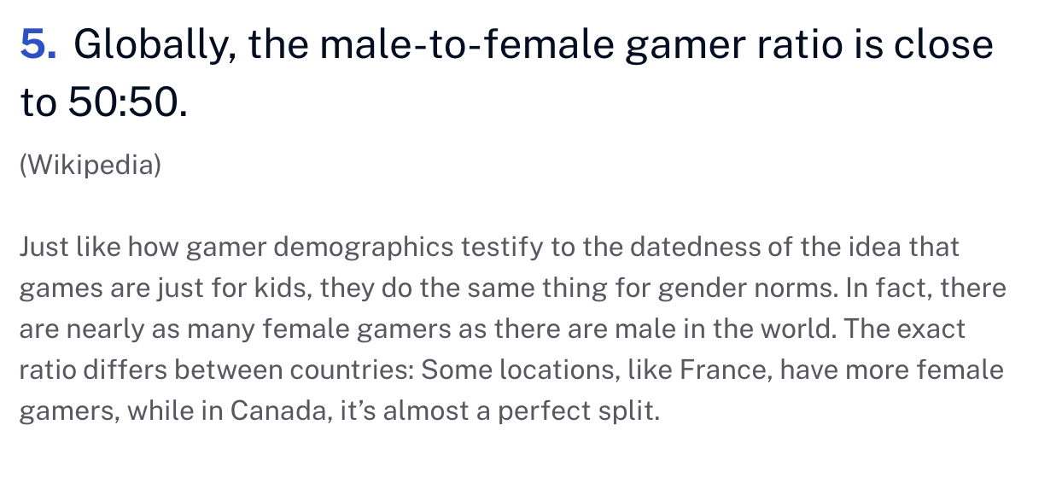
Recommendations: gender
For Turtle Games female audience is bigger than male audience.
That is confirmed by a global trend (after Wikipedia) where gender split is 50-50.
This information can be used to conduct further research on channels where female users can be best reached by ads to monetise on that trend.

Slide 6
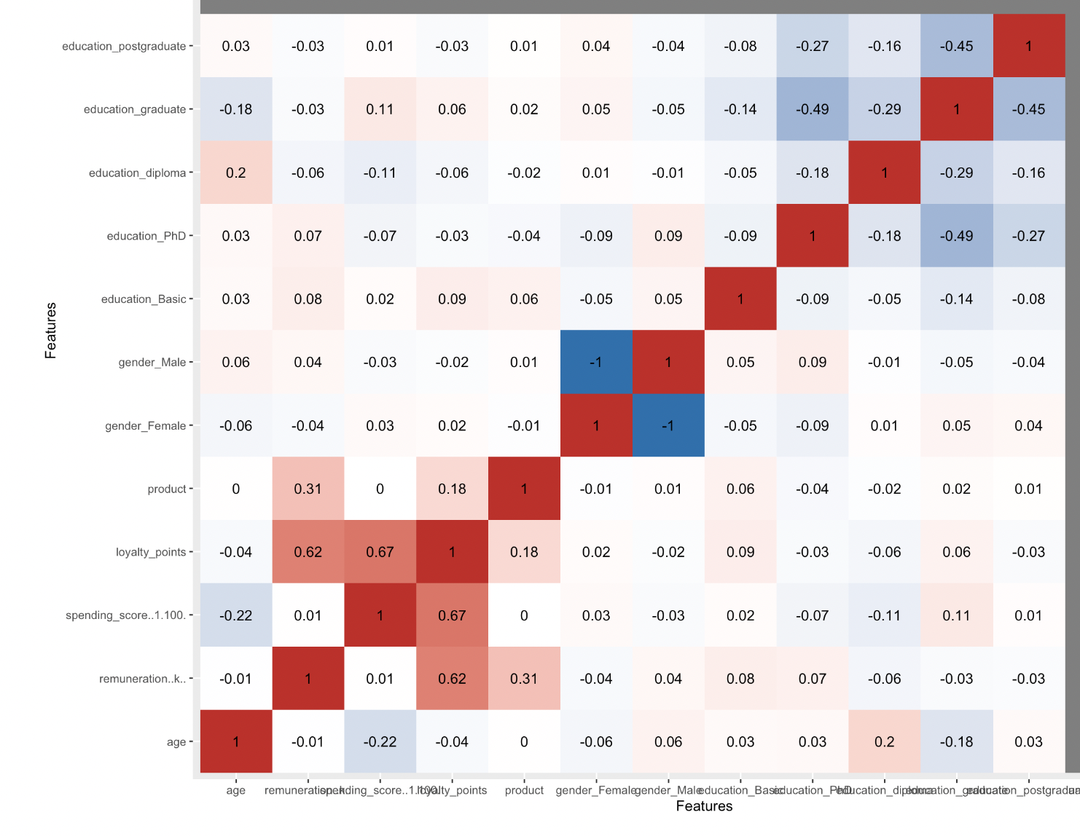
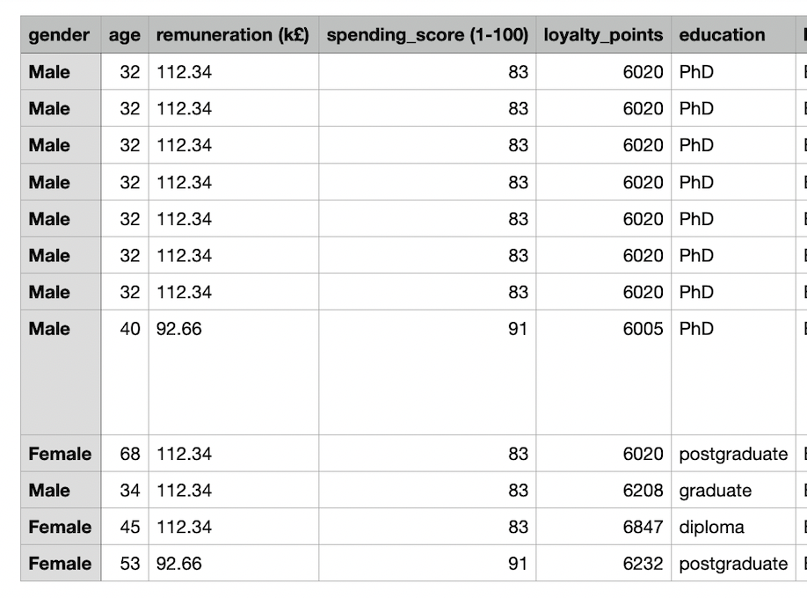
Recommendations: loyalty points
There is a correlation between loyalty points and the spending score of a customer.
It also appears that the holders of a majority of loyalty points are high earners.
If one doesn’t exist already, introducing a loyalty program is a good idea.

Slide 7
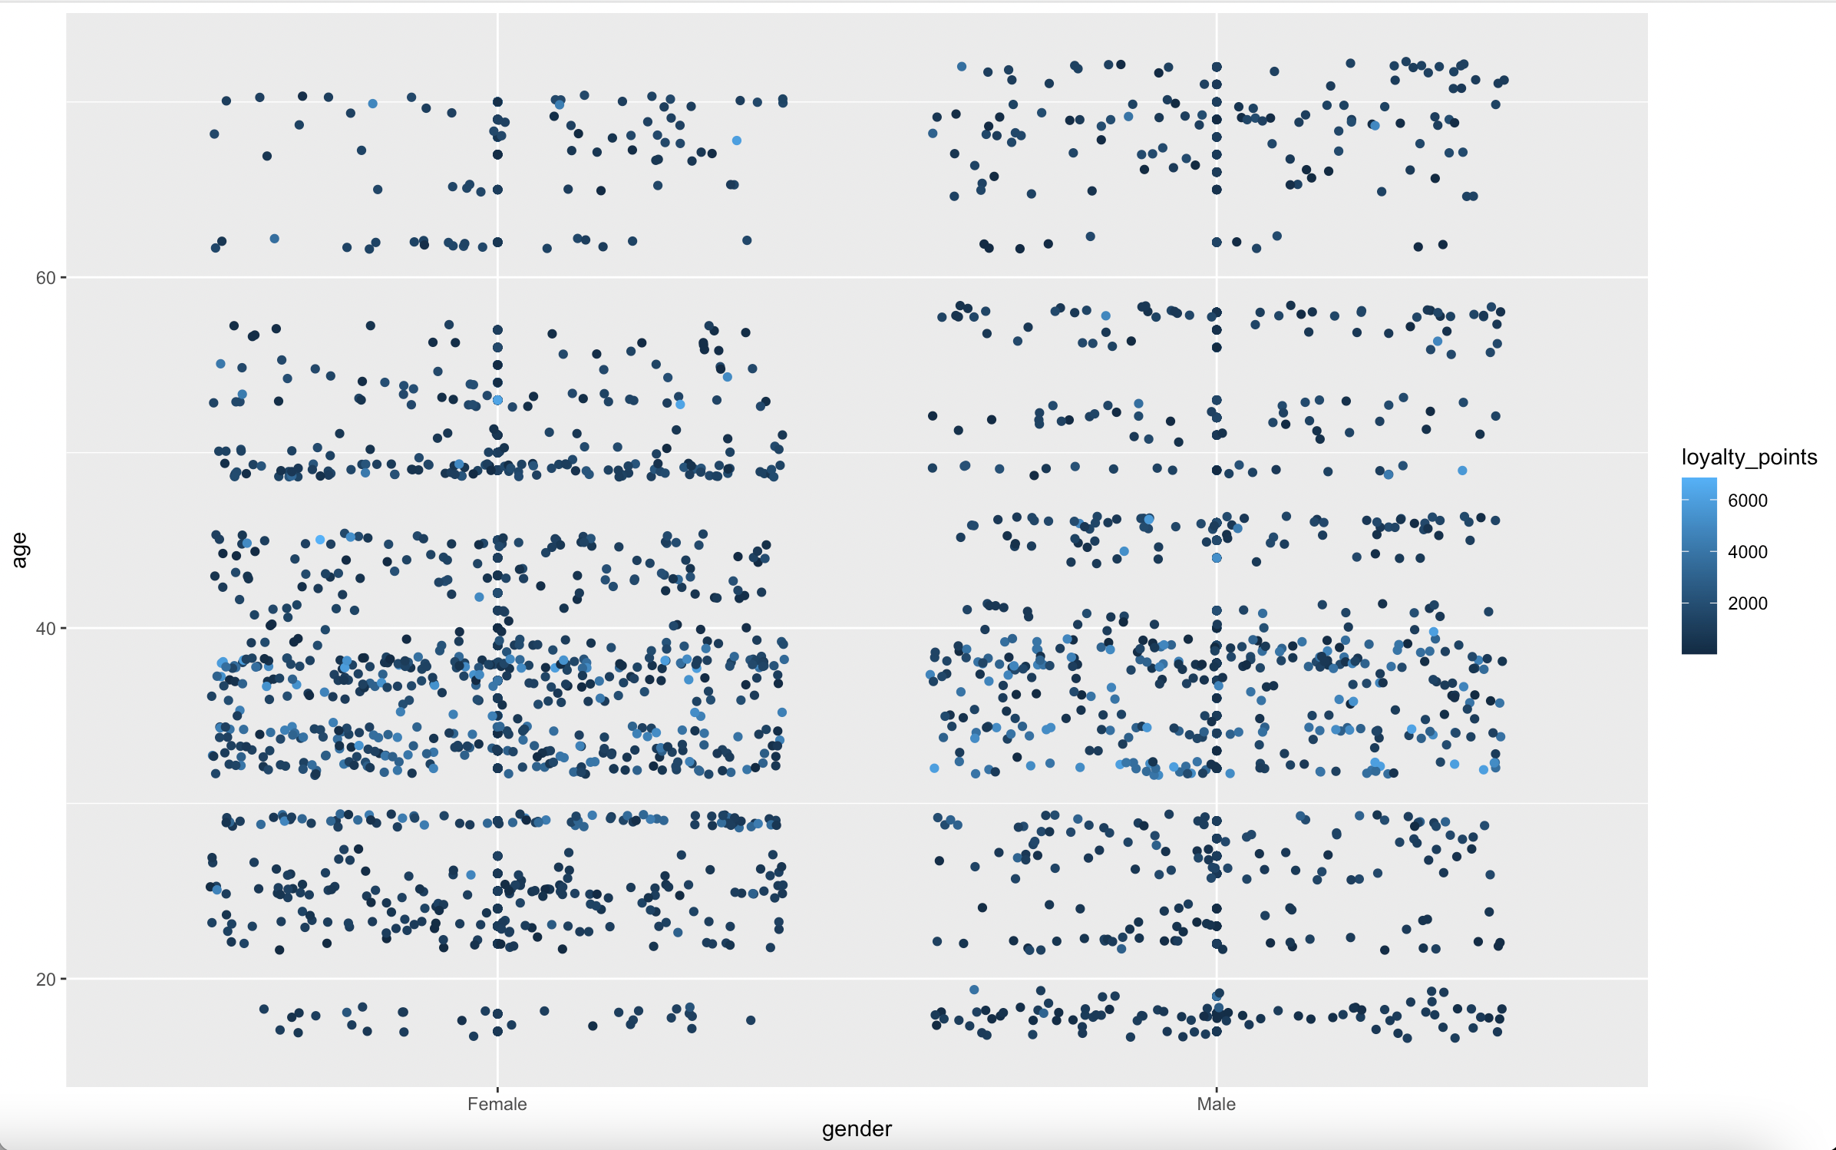
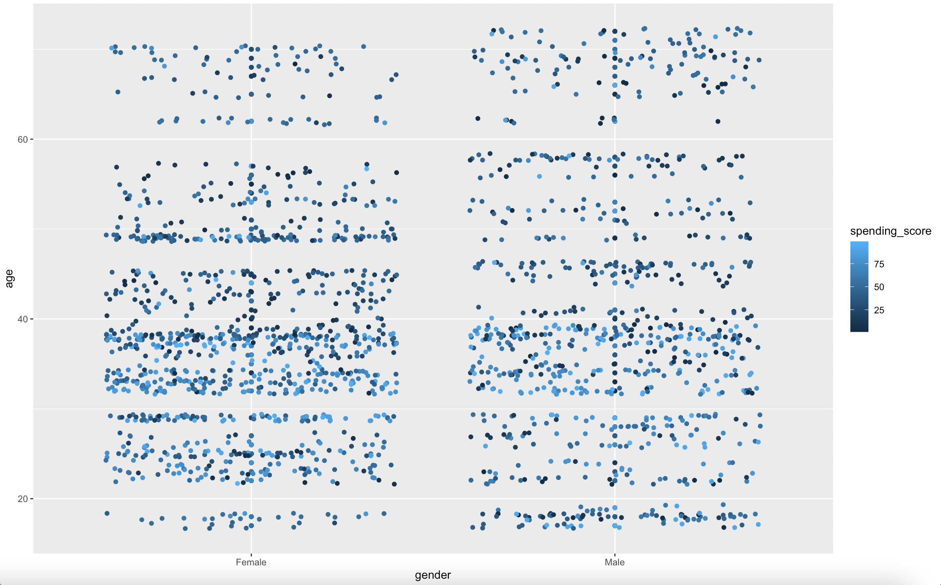
Scatter plots: loyalty points and spending score

Slide 8
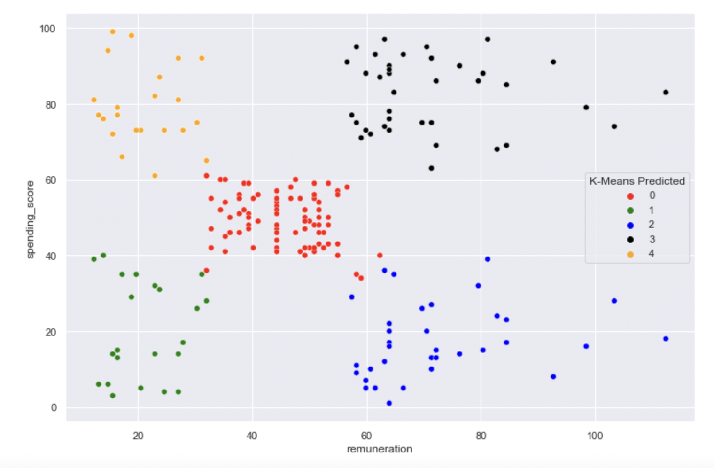
Recommendations: market segmentation
Market segmentation with k-means can inform customised email marketing efforts.
Segment no 3: high earners with a hight spending score can be reached with premium offers.
Segment no 2: high earners with a low spending score can be activated with discounts.

Slide 9
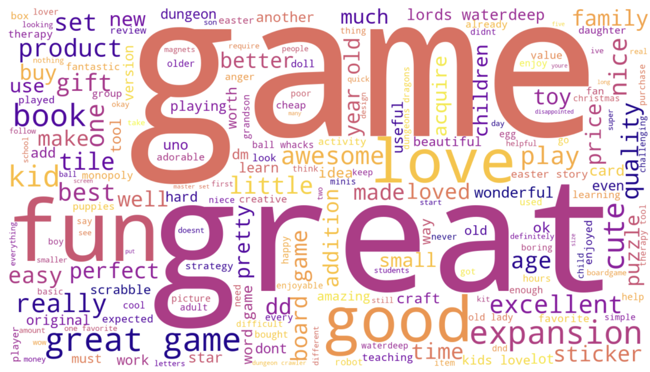
Recommendations: sentiment analysis
Turtle Games can utilise sentiment analysis to identify highly satisfied users and offer them loyalty programs.
As for negative feedback that should be addressed as well in an effort to avoid churn.
On top of that relevant content could be identified by regular analyse a set of keywords.

Slide 10
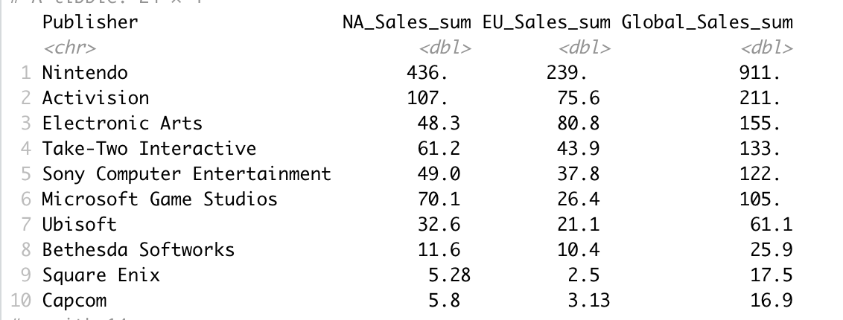
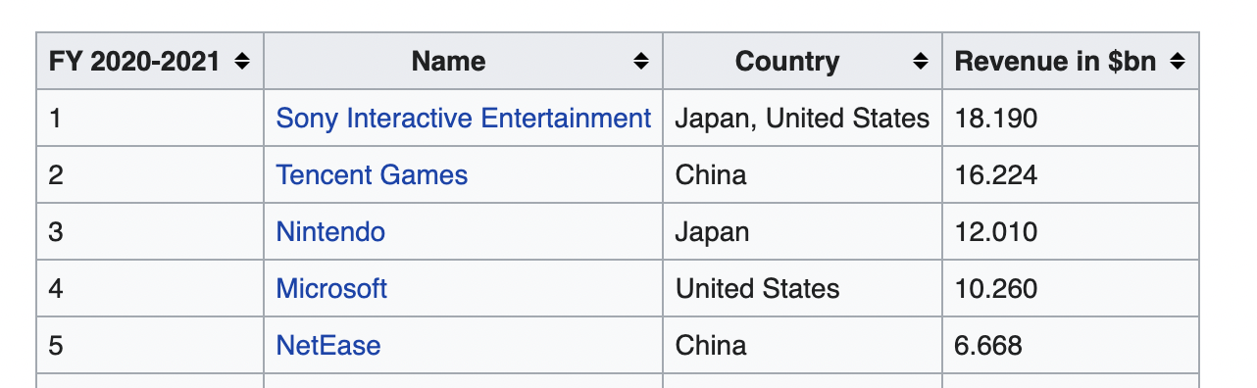
Recommendations: publishers
Highest seller for Turtle Games is by far Nintendo.
I would recommend looking into product range offered from Sony to maximise earning.
Turtle Games should also consider introducing Tencenet Games products into their offer.

Slide 11
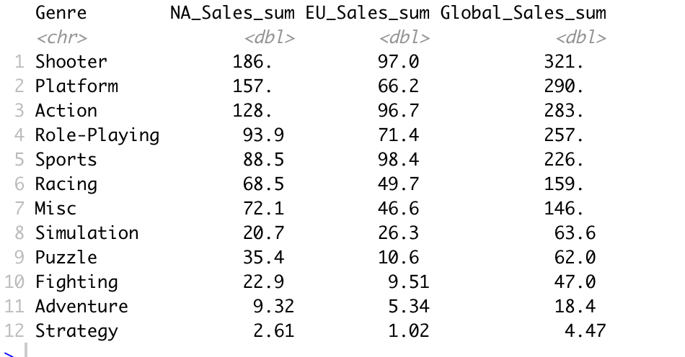
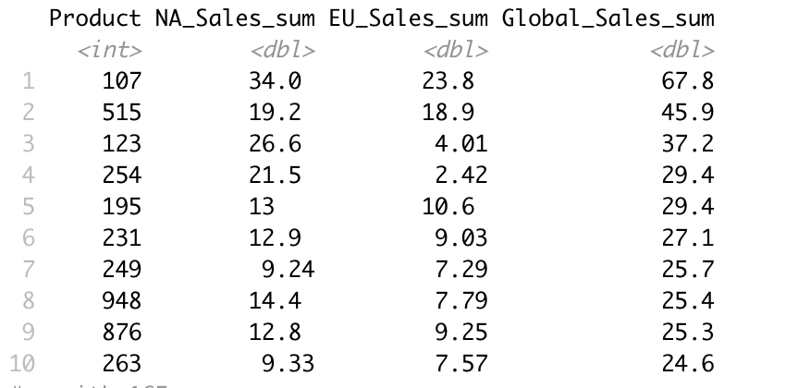
Recommendations: best-sellers
The most popular game type is a shooter game.
Analysis has also shown three most sold products: 107 (sports game released by Nintendo for Wii), 515 (action game for PS3 released by Take-Two Interactive) and 123 (Nintendo game sold for DS marked as miscellaneous).
That information could feed into Cyber Month and Christmas marketing campaigns.

Slide 12
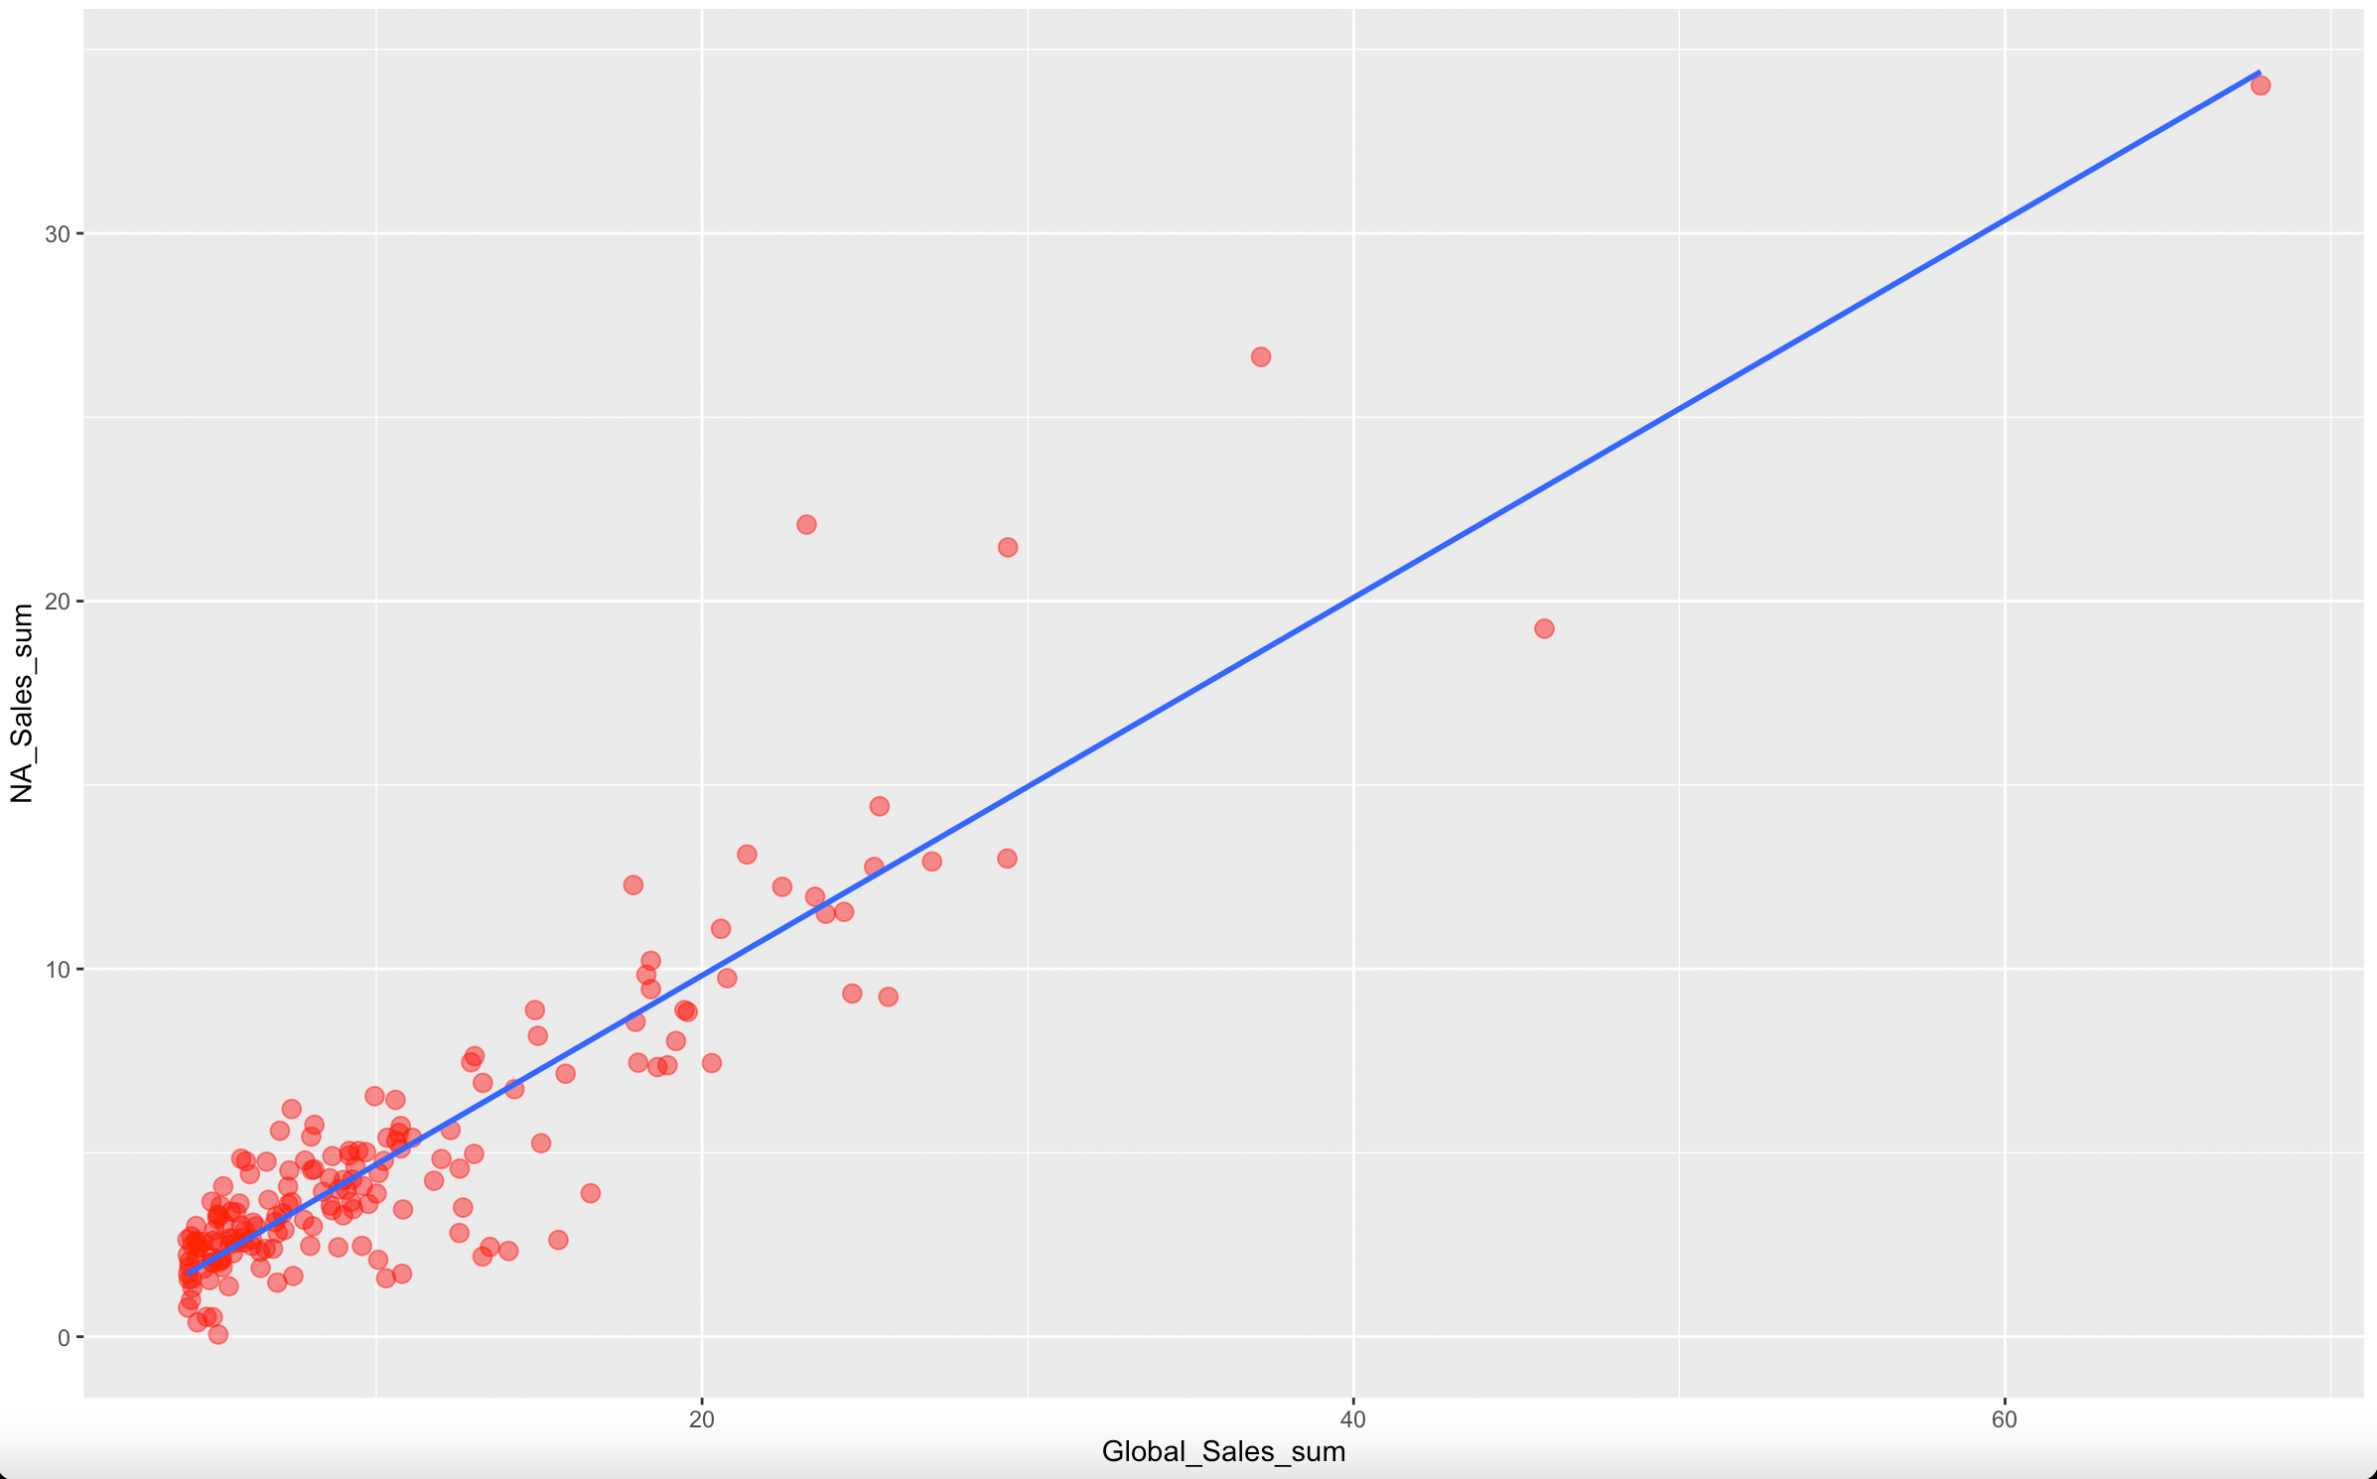
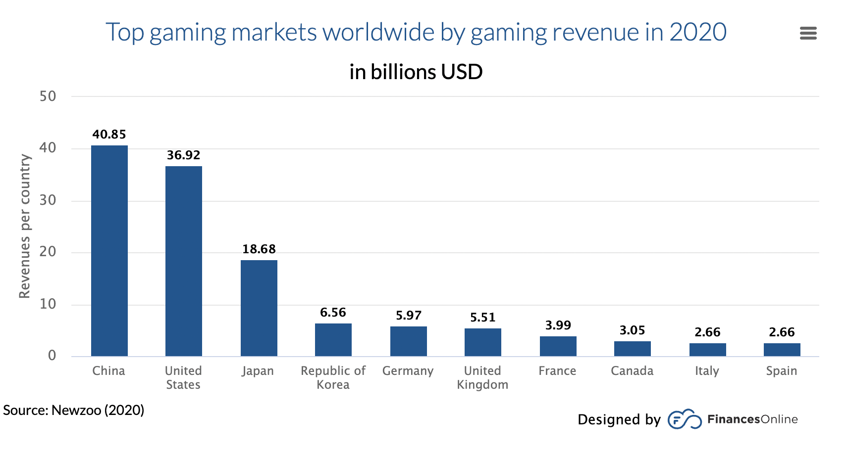
Recommendations: market focus
Finally, the research has identified that there is a strong correlation between North American sales and global sales. Focusing marketing spending in the US should result in a higher ROI.
Turtle Games could also consider market expansion to China and German-centric campaign to boost European sales.

Slide 13
Thank you for your attention.

